Slide 1
Unit V- Topic :Relational Data with dplyr Sub. Topic: Introduction
Multiple tables of data are called relational data because it is the relations, not just the individual datasets, that are important.
There are three families of verbs designed to work with relational data: \
Mutating joins, which add new variables to one data frame from matching observations in another.
Filtering joins, which filter observations from one data frame based on whether or not they match an observation in the other table.
Set operations, which treat observations as if they were set elements.
dplyr is a little easier to use than SQL because dplyr is specialized to do data analysis:

Slide 2
Sub. Topic :Prerequisites- nycights13
Use the nycights13 package to learn about relational data.
nycights13 contains four tibbles that are related to the flights table
library(tidyverse)/library(dplyr)
library(nycflights13)

Slide 3
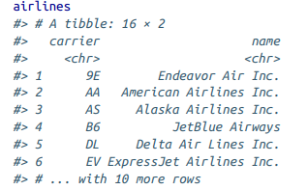
Sub. Topic :Prerequisites- nycights13
airlines gives the full carrier name from its abbreviated code:

Slide 4
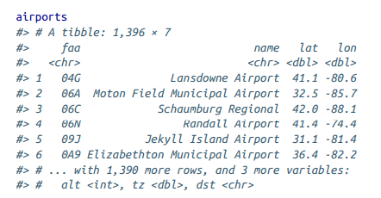
Sub. Topic :Prerequisites- nycights13
airports gives information about each airport, identified by the faa airport code:
The variables..lat, lon--Location of airport.,alt---Altitude, in feet, tz---Timezone offset from GMT, dst---Daylight savings time zone

Slide 5
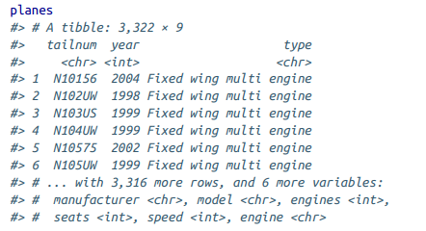
Sub. Topic :Prerequisites- nycights13
planes gives information about each plane, identified by its tailnum: The variables
manufacturer, model---Manufacturer and model, engines, seats---Number of engines and seats, speed—Average speed in mph, engine---Type of engine.

Slide 6
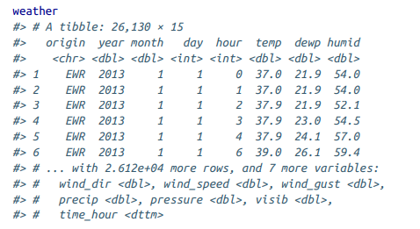
Sub. Topic :Prerequisites- nycights13
weather gives the weather at each NYC airport for each hour:
The variables: --year, month, day, hour--Time of recording, temp,dewp---Temperature and dewpoint in F, humid---Relative humidity, wind_dir, wind_speed, wind_gust---Wind direction (in degrees), speed and gust speed (in mph), precip---Precipitation, in inches, pressure---Sea level pressure in millibars, visib---Visibility in miles, time_hour----Date and hour of the recording as a POSIXct date.

Slide 7
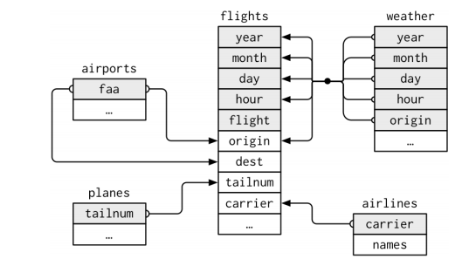
Relationships between the different tables

Slide 8
Relationships between the different tables
Understand the chain of relations between the tables
flights connects to planes via a single variable, tailnum.
flights connects to airlines through the carrier variable.
flights connects to airports in two ways: via the origin and dest variables.
flights connects to weather via origin (the location), and year, month, day, and hour (the time).

Slide 9
Prerequisites- nycights13 -Exercises
1. Imagine you wanted to draw (approximately) the route each plane flies from its origin to its destination. What variables would you need? What tables would you need to combine?
Drawing the routes requires the latitude and longitude of the origin and the destination airports of each flight.
This requires the flights and airports tables.
The flights table has the origin (origin) and destination (dest) airport of each flight. The airports table has the longitude (lon) and latitude (lat) of each airport.

Slide 10
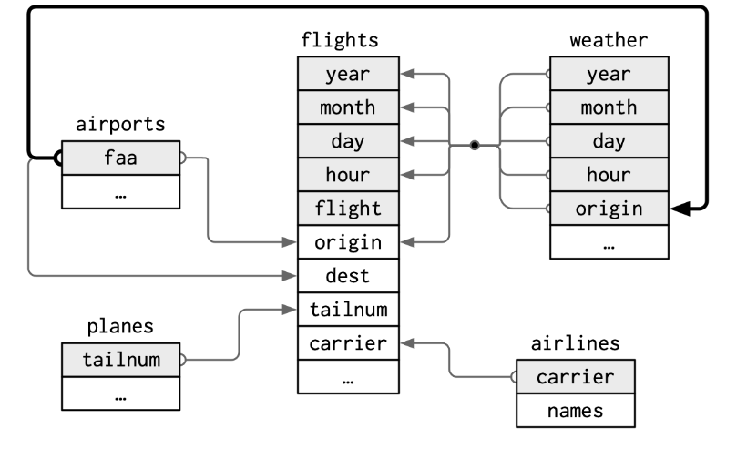
Prerequisites- nycights13 -Exercises
2. I forgot to draw the relationship between weather and air ports. What is the relationship and how should it appear in the diagram?
The column airports$faa is a foreign key of weather$origin.

Slide 11
Prerequisites- nycights13 -Exercises
3. weather only contains information for the origin (NYC) airports. If it contained weather records for all airports in the USA, what additional relation would it define with flights?
If the weather was included for all airports in the US, then it would provide the weather for the destination of each flight.
The weather data frame columns (year, month, day, hour, origin) are a foreign key for the flights data frame columns (year, month, day, hour, dest).
This would provide information about the weather at the destination.
So adding these relationship prior to weather table is not necessary.

Slide 12
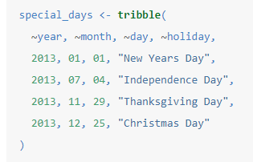
Prerequisites- nycights13 -Exercises
4. We know that some days of the year are “special,” and fewer people than usual fly on them. How might you represent that data as a data frame? What would be the primary keys of that table? How would it connect to the existing tables?
Add a table of special dates, with the following structure
The primary key of the table would be the (year, month, day) columns. The (year, month, day) columns could be used to join special_days with other tables.

Slide 13
Sub. Topic: Keys
The variables used to connect each pair of tables are called keys.
A key is a variable (or set of variables) that uniquely identifies an observation
In simple cases, a single variable is sufficient to identify an observation. For example, each plane is uniquely identified by its tailnum.
In other cases, multiple variables may be needed. For example, to identify an observation in weather you need five vari‐ ables: year, month, day, hour, and origin.
There are two types of keys:
A primary key uniquely identifies an observation in its own table. For example, planes$tailnum is a primary key because it uniquely identifies each plane in the planes table.
A foreign key uniquely identifies an observation in another table. For example, flights$tailnum is a foreign key because it appears in the flights table where it matches each flight to a unique plane

Slide 14

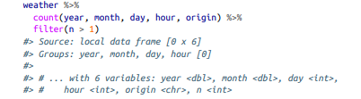
Sub. Topic: Keys
A variable can be both a primary key and a foreign key. For example, origin is part of the weather primary key, and is also a foreign key for the airport table.
To identify the primary keys in tables, it’s good practice to verify that they do indeed uniquely identify each observation.
One way to do that is to count() the primary keys and look for entries where n is greater than one

Slide 15
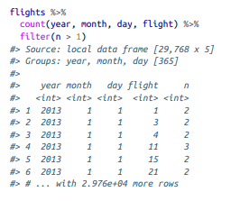
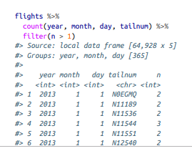
Sub. Topic: Keys
Sometimes a table doesn’t have an explicit primary key: each row is an observation, but no combination of variables reliably identifies it.
For example, what’s the primary key in the flights table? it would be the date plus the flight or tail number,

Slide 16
Sub. Topic: Keys
If a table lacks a primary key, it’s sometimes useful to add one with mutate() and row_number().
That makes it easier to match observations if done some filtering and want to check back in with the original data.
This is called a surrogate key.

Slide 17
Sub. Topic: Keys
A primary key and the corresponding foreign key in another table form a relation.
Relations are typically one-to-many. For example, each flight has one plane, but each plane has many flights.
In other data, there is a 1-to-1 relationship. or many-to-many relations with a many-to-1 relation plus a 1-to-many relation.
For example, in this data there’s a many-to-many relationship between airlines and airports: each airline flies to many airports; each airport hosts many airlines.

Slide 18
Keys-Exercises
1. Add a surrogate key to flights
Add the column flight_id as a surrogate key. Sort the data prior to making the key, even though it is not strictly necessary, so the order of the rows has some meaning.
flights%>%arrange(year, month, day, sched_dep_time, carrier, flight)%>%mutate(flight_id=row_number() )%>%glimpse()

Slide 19
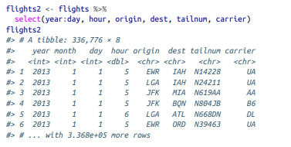
Sub. Topic: Mutating Joins
A mutating join allows to combine variables from two tables.
It first matches observations by their keys, then copies across variables from one table to the other.
First creating a narrower dataset from flights----flights2 <- flights %>% select(year:day, hour, origin, dest, tailnum, carrier)

Slide 20
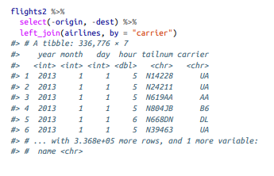
Sub. Topic: Mutating Joins
To add the full airline name to the flights2 data, combine the airlines and flights2 data frames with left_join():
flights2 %>% select(-origin, -dest) %>% left_join(airlines, by = "carrier")
The result of joining airlines to flights2 is an additional variable: name. This is why this type of join a mutating join

Slide 21
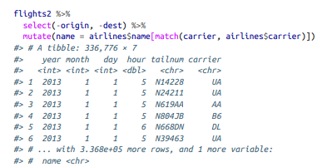
Sub. Topic: Mutating Joins
Got to the same result using mutate() and R’s base subsetting:
flights2 %>% select(-origin, -dest) %>% mutate(name = airlines$name[match(carrier, airlines$carrier)])
But this is hard to match multiple variables

Slide 22

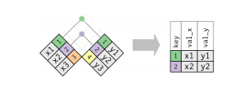
Sub. Topic: Mutating Joins
Understanding Joins
Four mutating join functions: the inner join, and the three outer joins

Slide 23
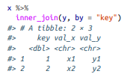

Sub. Topic: Mutating Joins
Inner Join:
The simplest type of join is the inner join. An inner join matches pairs of observations whenever their keys are equal:
The most important property of an inner join is that unmatched rows are not included in the result.
x <- tribble( ~key, ~val_x, 1, "x1", 2, "x2", 3, "x3")
y <- tribble( ~key, ~val_y, 1, "y1", 2, "y2", 4, "y3")
x %>% inner_join(y, by = "key")

Slide 24
Sub. Topic: Mutating Joins
Outer Joins
An inner join keeps observations that appear in both tables.
An outer join keeps observations that appear in at least one of the tables.
There are three types of outer joins:
• A left join keeps all observations in x.
• A right join keeps all observations in y.
• A full join keeps all observations in x and y.

Slide 25
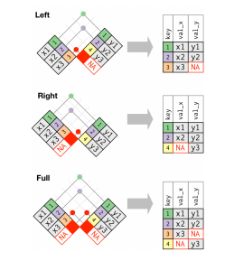
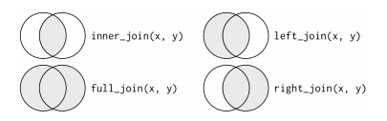
Sub. Topic: Mutating Joins

Slide 26
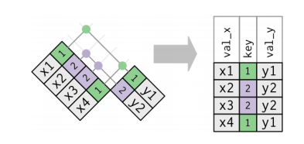
Sub. Topic: Mutating Joins
Duplicate Keys:
So far all the diagrams have assumed that the keys are unique.
But sometimes, the keys are not unique.
There are two possibilities:
1. One table has duplicate keys.
x <- tribble( ~key, ~val_x, 1, "x1", 2, "x2", 2, "x3", 1, "x4")
y <- tribble( ~key, ~val_y, 1, "y1", 2, "y2")
left_join(x, y, by = "key")

Slide 27
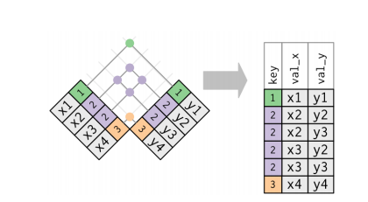
Sub. Topic: Mutating Joins
2. Both tables have duplicate keys.
When join these tables, get all possible combinations, the Cartesian product as result.
x <- tribble( ~key, ~val_x, 1, "x1", 2, "x2", 2, "x3", 3, "x4")
y <- tribble( ~key, ~val_y, 1, "y1", 2, "y2", 2, "y3", 3, "y4")
left_join(x, y, by = "key")

Slide 28
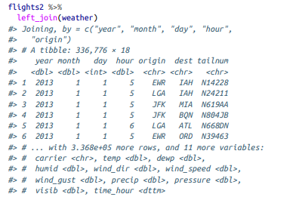
Sub. Topic: Mutating Joins
Defining the Key Columns:
So far, the pairs of tables have always been joined by a single variable, and that variable has the same name in both tables.
That constraint was encoded by "key".
Can use other values for by to connect the tables in other ways
1. The default, by = NULL, uses all variables that appear in both tables, the so-called natural join.
flights2 %>% left_join(weather)
#> Joining, by = c("year", "month", "day", "hour", #> "origin")

Slide 29
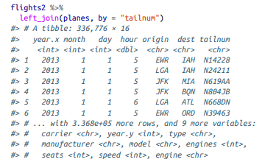
Sub. Topic: Mutating Joins
2. A character vector, by = "x". This is like a natural join, but uses only some of the common variables.
For example, flights and planes have year variables, but they mean different things so only join by tailnum:
flights2 %>% left_join(planes, by = "tailnum")
Note that the year variables (which appear in both input data frames, but are not constrained to be equal) are disambiguated in the output with a suffix.

Slide 30
Sub. Topic: Mutating Joins
3. A named character vector: by = c("a" = "b"). This will match variable a in table x to variable b in table y. The variables from x will be used in the output.
For example, if want to draw a map, then need to combine the flights data with the airports data, which contains the location (lat and long) of each airport.
Each flight has an origin and destination airport, so specify which one want to join to
flights2 %>% left_join(airports, c("dest" = "faa"))
flights2 %>% left_join(airports, c("origin" = "faa"))

Slide 31
Mutating Joins- Exercises
1. Compute the average delay by destination, then join on the air ports data frame so you can show the spatial distribution of delays.
avg_dest_delays <- flights %>% group_by(dest) %>% summarise(delay = mean(arr_delay, na.rm = TRUE)) %>% inner_join(airports, by = c(dest = "faa"))
avg_dest_delays %>% ggplot(aes(lon, lat, colour = delay)) + geom_point()

Slide 32
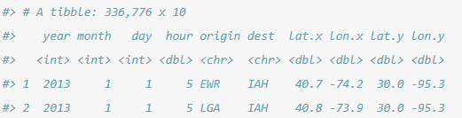
Mutating Joins- Exercises
2. Add the location of the origin and destination (i.e. the lat and lon) to flights.
airport_locations <- airports %>% select(faa, lat, lon)
flights %>% select(year:day, hour, origin, dest) %>% left_join( airport_locations, by = c("origin" = "faa") ) %>% left_join( airport_locations, by = c("dest" = "faa") )

Slide 33
Mutating Joins- Exercises
3. What weather conditions make it more likely to see a delay?
Almost any amount of rainfall is associated with a delay., so consider the variable precip--Precipitation, in inches
flight_weather <- flights %>% inner_join(weather, by = c( "origin" = "origin", "year" = "year", "month" = "month", "day" = "day", "hour" = "hour" ))
flight_weather %>% group_by(precip) %>% summarise(delay = mean(dep_delay, na.rm = TRUE)) %>% ggplot(aes(x = precip, y = delay)) + geom_line() + geom_point()

Slide 34
Mutating Joins- Exercises
4. What happened on June 13, 2013? Display the spatial pattern of delays, and then use Google to cross-reference with the weather.
flights %>% filter(year == 2013, month == 6, day == 13) %>% group_by(dest) %>% summarise(delay = mean(arr_delay, na.rm = TRUE)) %>% inner_join(airports, by = c("dest" = "faa")) %>% ggplot(aes( x = lon,y = lat, color = delay)) + geom_point()

Slide 35
Sub. Topic: Mutating Joins
Other Implementations
base::merge() can perform all four types of mutating join:
dplyr merge
inner_join(x, y) merge(x, y)
left_join(x, y) merge(x, y, all.x = TRUE)
right_join(x, y) merge(x, y, all.y = TRUE)
full_join(x, y) merge(x, y, all.x = TRUE, all.y = TRUE)

Slide 36
Sub. Topic: Mutating Joins
Other Implementations
dplyr SQL
inner_join(x, y, by = "z") SELECT * FROM x INNER JOIN y USING (z)
left_join(x, y, by = "z") SELECT * FROM x LEFT OUTER JOIN y USING (z)
right_join(x, y, by = "z") S ELECT * FROM x RIGHT OUTER JOIN y USING (z) full_join(x, y, by = "z") SELECT * FROM x FULL OUTER JOIN y USING (z)

Slide 37
Sub.Topic :Filtering Joins
Filtering joins match observations in the same way as mutating joins, but affect the observations, not the variables.
There are two types:
• semi_join(x, y) keeps all observations in x that have a match in y.
• anti_join(x, y) drops all observations in x that have a match in y.

Slide 38
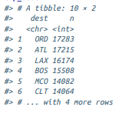
Sub.Topic :Filtering Joins
Semi-joins are useful for matching filtered summary tables back to the original rows.
For example, imagine you’ve found the top-10 most popular destinations:
top_dest <- flights %>% count(dest, sort = TRUE) %>% head(10)
top_dest

Slide 39
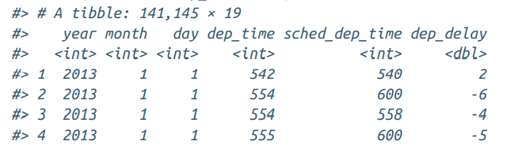
Sub.Topic :Filtering Joins
Now ,find each flight that went to one of those destinations.
flights %>% filter(dest %in% top_dest$dest)
But it’s difficult to extend that approach to multiple variables

Slide 40
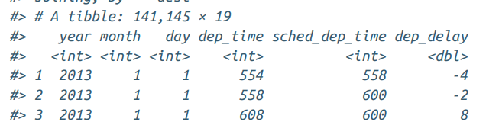
Sub.Topic :Filtering Joins
Use a semi-join, which connects the two tables like a mutating join, but instead of adding new columns, only keeps the rows in x that have a match in y:
flights %>% semi_join(top_dest)

Slide 41
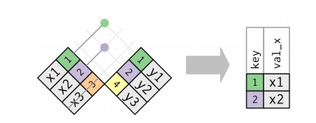
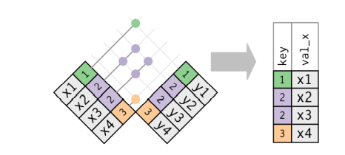
Sub.Topic :Filtering Joins
Graphical representation of semi-join:
Only the existence of a match is important; it doesn’t matter which observation is matched. This means that filtering joins never dupli‐ cate rows like mutating joins do:

Slide 42
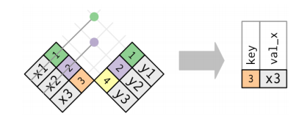
Sub.Topic :Filtering Joins
The inverse of a semi-join is an anti-join.
An anti-join keeps the rows that don’t have a match:
Anti-joins are useful for diagnosing join mismatches.
For example, when connecting flights and planes, can find that there are many flights that don’t have a match in planes:
flights %>% anti_join(planes, by = "tailnum") %>% count(tailnum, sort = TRUE)
flights %>% anti_join(planes, by = "tailnum") %>% count(tailnum, sort = TRUE)

Slide 43
Filtering Joins- Exercises
1. What does it mean for a flight to have a missing tailnum? What do the tail numbers that don’t have a matching record in planes have in common? (Hint: one variable explains ~90% of the problems.)
Flights that have a missing tailnum , meaning that the flight was canceled.
flights %>% filter(is.na(tailnum) )%>% nrow()
Many of the tail numbers that don’t have a matching value in planes are registered to American Airlines (AA) or Envoy Airlines (MQ). The documentation for planes states
American Airways (AA) and Envoy Air (MQ) report fleet numbers rather than tail numbers so can’t be matched.
flights %>% anti_join(planes, by = "tailnum") %>% count(carrier, sort = TRUE)

Slide 44
Filtering Joins- Exercises
2. Filter flights to only show flights with planes that have flown at least 100 flights.
planes_with100 <- flights %>%
filter(!is.na(tailnum)) %>%
group_by(tailnum) %>%
count() %>%
filter(n >= 100)
planes_with100
flights %>%
semi_join(planes_with100, by = "tailnum")

Slide 45
Filtering Joins- Exercises
5. What does anti_join(flights, airports, by = c("dest" = "faa")) tell you? What does anti_join(airports, flights, by = c("faa" = "dest")) tell you?
The expression anti_join(flights, airports, by = c("dest" = "faa")) returns the flights that went to an airport that is not in the FAA list of destinations.
Since the FAA list only contains domestic airports, these are likely foreign flights.
The expression anti_join(airports, flights, by = c("faa" = "dest")) returns the US airports that were not the destination of any flight in the data.

Slide 46
Sub. Topic: Join Problems
Start by identifying the variables that form the primary key in each table.
Check that none of the variables in the primary key are missing. If a value is missing then it can’t identify an observation!
Check that your foreign keys match primary keys in another table. The best way to do this is with an anti_join()

Slide 47
Sub. Topic: Set Operations
These expect the x and y inputs to have the same variables, and treat the observations like sets:
intersect(x, y)
Return only observations in both x and y.
union(x, y)
Return unique observations in x and y.
setdiff(x, y)
Return observations in x, but not in y.

Slide 48
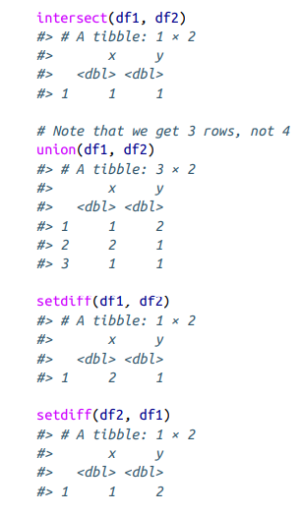
Sub. Topic: Set Operations
df1 <- tribble( ~x, ~y, 1, 1, 2, 1)
df2 <- tribble( ~x, ~y, 1, 1, 1, 2)
intersect(df1,df2)
union(df1, df2)
setdiff(df1, df2)
setdiff(df2, df1)

Slide 49
Topic: R Markdown Sub.Topic: Introduction
R Markdown provides a unified authoring framework for data sci‐ ence, combining code, its results, and prose commentary.
R Markdown documents are fully reproducible and support dozens of output formats, like PDFs, Word files, slideshows, and more.
R Markdown files are designed to be used in three ways:
For communicating to decision makers, who want to focus on the conclusions, not the code behind the analysis.
For collaborating with other data scientists ,who are interested in both conclusions, and how to reached them (i.e., the code).
As an environment in which to do data science, as a modern day lab notebook where you can capture not only what you did, but also what you were thinking

Slide 50
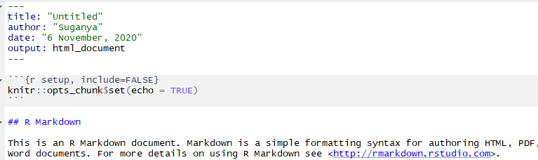
Sub. Topic: R Markdown Basics
Prerequisites
Need the rmarkdown package, but need not to explicitly install it or load it, as RStudio automatically does both when needed.
This is an R Markdown file, a plain-text file that has the extension .Rmd:

Slide 51
Sub. Topic: R Markdown Basics
The file contains three important types of content:
1. An (optional) YAML header surrounded by ---s.
2. Chunks of R code surrounded by ```.
3. Text mixed with simple text formatting like # heading and _italics_.
When knit the document R Markdown sends the .Rmd file to knitr, which executes all of the code chunks and creates a new Markdown (.md) document that includes the code and its output.
The Markdown file generated by knitr is then processed by pandoc, which is responsible for creating the finished file.
The advantage of this two-step workflow is that to create a very wide range of output formats

Slide 52

Sub. Topic: R Markdown Basics
To get started with own .Rmd file,
select File → New File → R Markdown…
in the menu bar.
RStudio will launch a wizard that can use to pre-populate file with useful content that reminds how the key features of R Markdown work.

Slide 53
R Markdown Basics –Exercises-Refer Video 1
1. Create a new notebook using File → New File → R Notebook. Read the instructions. Practice running the chunks. Verify that you can modify the code, rerun it, and see modified output.
2. Create a new R Markdown document with File → New File → R Markdown… Knit it by clicking the appropriate button. Knit it by using the appropriate keyboard shortcut. Verify that you can modify the input and see the output update.

Slide 54
R Markdown Basics –Exercises-Refer Video 1
3. Compare and contrast the R Notebook and R Markdown files you created earlier. How are the outputs similar? How are they different? How are the inputs similar? How are they different? What happens if you copy the YAML header from one to the other?
RStudio new file option has both R Markdown and R NoteBook and selecting either of them opens an R Markdown file but with minor differences.
R notebook will generate a file with extension of .nb
Both R notebooks and R markdown files and can be knit to produce HTML output.
R notebook files show the output of code chunks inside the editor. This makes R notebook documents appealing for interactive exploration.
This contrasts with R markdown files, which show their output inside the console, and do not show output inside the editor. In this R markdown file, the plot is displayed in the “Plot” tab, while the output of summary() is displayed in the tab.

Slide 55
Sub. Topic: Text Formatting with Markdown-Refer Video 2
Prose in .Rmd files is written in Markdown, a lightweight set of conventions for formatting plain-text files.
Markdown is designed to be easy to read and easy to write.
It is also very easy to learn.
*italic* /**bold**
# 1st Level Header
## 2nd Level Header
### 3rd Level Header

Slide 56
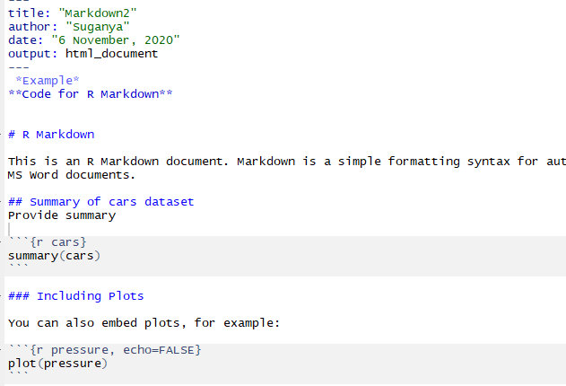
Sub. Topic: Text Formatting with Markdown-Refer Video 2

Slide 57
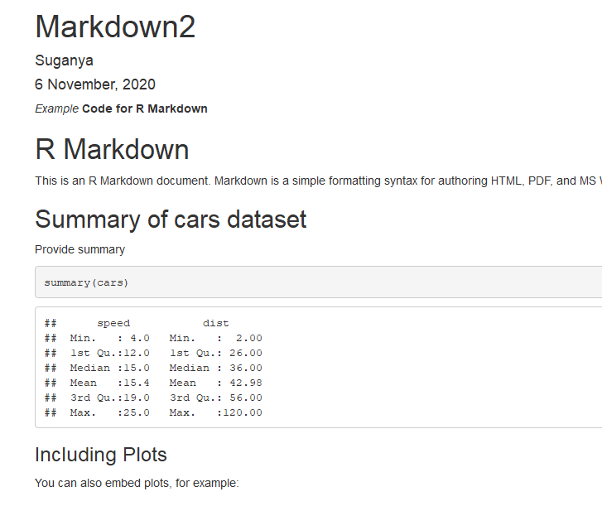
Sub. Topic: Text Formatting with Markdown-Refer Video 2

Slide 58
Sub. Topic: Code Chunks
To run code inside an R Markdown document, insert a chunk.
There are three ways to do so:
1. The keyboard shortcut Cmd/Ctrl-Alt-I
2. The “Insert” button icon in the editor toolbar
3. By manually typing the chunk delimiters ```{r} and ```
Chunk Name
Chunks can be given an optional name: ```{r by-name}.
This is useful to navigate a specific chunks using the dropdown code navigator in the bottom-left of the script editor

Slide 59
Sub. Topic: Code Chunks
Chunk Options
Chunk output can be customized with options, arguments supplied to the chunk header
The most important set of options
eval = FALSE prevents code from being evaluated. (And obviously if the code is not run, no results will be generated.)
include = FALSE runs the code, but doesn’t show the code or results in the final document.
echo = FALSE prevents code, but not the results from appearing in the finished file.

Slide 60
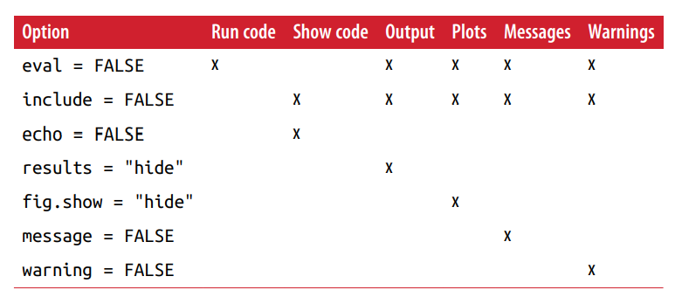
Sub. Topic: Code Chunks
message = FALSE or warning = FALSE prevents messages or warnings from appearing in the finished file.
results = 'hide' hides printed output; fig.show = 'hide' hides plots.
error = TRUE causes the render to continue even if code returns an error

Slide 61
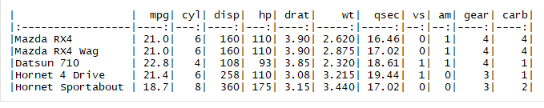
Sub. Topic: Code Chunks
Table
By default, R Markdown prints data frames and matrices as you’d see them in the console
The data be displayed with additional formatting by using the knitr::kable function.
The following code generates Table
knitr::kable( mtcars[1:5, ] )

Slide 62
Sub. Topic: Code Chunks
Caching
Normally, each knit of a document starts from a completely clean slate.
This is great for reproducibility, because it ensures that every important computation in code.
However, for some computations that take a long time.
The solution is cache = TRUE.
When set, this will save the output of the chunk to a specially named file on disk.
On subsequent runs, knitr will check to see if the code has changed, and if it hasn’t, it will reuse the cached results.

Slide 63
Sub. Topic: Code Chunks
The caching system must be used with care, because by default it is based on the code only, not its dependencies.
For example, here the processed_data chunk depends on the raw_data chunk:
```{r raw_data}
rawdata <- readr::read_csv("a_very_large_file.csv")
```
```{r processed_data, cached = TRUE}
processed_data <- rawdata %>%
filter(!is.na(import_var)) %>%
mutate(new_variable = complicated_transformation(x, y, z))
```

Slide 64
Sub. Topic: Code Chunks
Caching the processed_data chunk means that it will get rerun if the dplyr pipeline is changed, but it won’t get rerun if the read_csv() call changes.
Can avoid that problem with the dependson chunk option:
```{r processed_data, cached = TRUE, dependson = "raw_data"}
processed_data <- rawdata %>% filter(!is.na(import_var)) %>%
mutate(new_variable = complicated_transformation(x, y, z))
```
dependson should contain a character vector of every chunk that the cached chunk depends on.
knitr will update the results for the cached chunk whenever it detects that one of its dependencies has changed.

Slide 65
Sub. Topic: Code Chunks
Global Options
To change the default chunk options by calling knitr::opts_chunk$set() in a code chunk.
For example, when writing books and tutorials I set:
knitr::opts_chunk$set( comment = "#>", collapse = TRUE )
This uses preferred comment formatting, and ensures that the code and output are kept closely entwined.
On the other hand, when preparing a report, set:
knitr::opts_chunk$set( echo = FALSE )
That will hide the code by default

Slide 66
Code Chunks- Exercises-Refer Video 3
1. Add a section that explores how diamond sizes vary by cut, color, and clarity. Assume you’re writing a report for someone who doesn’t know R, and instead of setting echo = FALSE on each chunk, set a global option.
---
title: "Diamond sizes"
author: "Suganya"
date: "7 November, 2020"
output: html_document
---

Slide 67
Code Chunks- Exercises-Refer Video 3
```{r knitr_opts, include = FALSE}
knitr::opts_chunk$set(echo = FALSE)
```
```{r setup, message = FALSE}
library("ggplot2")
library("dplyr")
```
## Size and Cut, Color, and Clarity

Slide 68
Code Chunks- Exercises-Refer Video 3
Diamonds with lower quality cuts (cuts are ranked from "Ideal" to "Fair") tend
to be larger.
```{r}
ggplot(diamonds, aes(y = carat, x = cut)) +
geom_boxplot()
```
Likewise, diamonds with worse color (diamond colors are ranked from J (worst)
to D (best)) tend to be larger:

Slide 69
Code Chunks- Exercises-Refer Video 3
```{r}
ggplot(diamonds, aes(y = carat, x = color)) +
geom_boxplot()
```
The pattern present in cut and color is also present in clarity. Diamonds with
worse clarity (I1 (worst), SI1, SI2, VS1, VS2, VVS1, VVS2, IF (best)) tend to
be larger:
```{r}
ggplot(diamonds, aes(y = carat, x = clarity)) +
geom_boxplot()
```

Slide 70
Sub. Topic: Troubleshooting
Troubleshooting R Markdown documents can be challenging
The first thing you should always try is to re-create the problem in an interactive session.
Restart R, then “Run all chunks”
If you’re lucky, that will re-create the problem, and you can figure out what’s going on interactively.
If that doesn’t help, there must be something different between your interactive environment and the R Markdown environment.
You’re going to need to systematically explore the options.
The most common difference is the working directory: the working directory of an R Markdown document is the directory in which it lives.
Check that the working directory is what you expect by including getwd() in a chunk.
Next, brainstorm all of the things that might cause the bug.

Slide 71
Sub. Topic: YAML Header
Control many other “whole document” settings by tweaking the parameters of the YAML header
YAML stands for: it’s “yet another markup language,” which is designed for representing hierarchical data in a way that’s easy for humans to read and write.
R Markdown uses it to control many details of the output.
Parameters
R Markdown documents can include one or more parameters whose values can be set when render the report.
Parameters are useful when re-render the same report with distinct values for various key inputs.
This example use a my_class parameter to determine which class of cars to display:

Slide 72
Sub. Topic: YAML Header
---
output: html_document
params:
my_class: "suv"
---
```{r setup, include = FALSE}
library(ggplot2)
library(dplyr)
class <- mpg %>% filter(class == params$my_class)
```

Slide 73
Sub. Topic: YAML Header
# Fuel economy for `r params$my_class`s
```{r, message = FALSE}
ggplot(class, aes(displ, hwy)) +
geom_point() +
geom_smooth(se = FALSE)
```

